Slide 1
BLUETOOTH 5.0
Subject : Mobile Computing & Wireless Communication (2170710)
Semester: 7
Team-members: Maitrarajsinh (170210107013)
Jeel (170210107043)
Ravirajsinh (170210107047)
Bhumit (170210107056)
College: Government Engineering College Bhavnagar.
Guided by: Prof. K.R. Rathod

Slide 2
CONTENTS
Basics of Bluetooth 5.0
More about Bluetooth 5.0
Security Concerns
Bluetooth 5.1
Applications

Slide 3
WHAT IS BLUETOOTH?
Bluetooth is a short-range and low power wireless technology originally developed for exchanging data over short distances from fixed and mobile devices, creating personal area networks(PANs).
Short range radio frequency technology that operates at 2.4 to 2.483 GHz on an Industrial Scientific Medical (ISM) band.
Effective practical range of Bluetooth devices is 10 meters with data rates up to 1 Mb/s.
Bluetooth Low Energy (BLE) has been actively evolved to make it a key enabler of the Internet of Things (IoT), focusing on the edge tier of IoT systems.

Slide 4
NEED OF BLUETOOTH 5.0 (Features):
ABI Research now forecasts that by 2021 there will be 48 billion devices connected to the internet, in what we’re likely to term the age of the IoT. Of those 48 billion devices, 30% are forecasted to include Bluetooth technology.
Bluetooth 5 is a transformative update that significantly increases the range, speed, and broadcast messaging capacity of Bluetooth applications and makes use cases in smart home automation, enterprise, and industrial markets a reality.
2x Speed: Bluetooth 4.x devices only support a single 1 Mbps PHY rate, but Bluetooth 5.0 devices are capable of either supporting 1 or 2 Mbps rates. This leads to reduced time required for transmitting and receiving data, saves power consumption.
Many use cases involving Bluetooth LE tend to involve small amounts of data, perhaps transmitted only occasionally. But there are use cases gaining prominence which demand a low-power wireless communications technology which supports higher data rates.

Slide 5
4x Range: Bluetooth 4.x and other devices only support around 100m of range for the wireless communication, whereas Bluetooth 5.0 supports around 400m which is quite convenient.
There are many use cases where greater range is advantageous. The smart home sector is one example and it has, to a degree, informed some of the goals behind Bluetooth 5 and its increased range.
Slot Availability Mask: Bluetooth 5 made some changes to help improve coexistence with other radio technologies on devices such as smart phones. Bluetooth uses the 2.4GHz ISM band and this is immediately adjacent to the Mobile Wireless Standard (MWS) bands, such as are used for LTE.
There’s potential for interference between the two systems, with transmissions from one desensitizing the receiver on the other. Bluetooth 5 introduces a system called Slot Availability Masks, which allows Bluetooth to indicate the availability of its time slots and to synchronize in an optimal manner with the use of the adjacent MWS bands.

Slide 6
Advertising Channels: Broadcasting packets in Bluetooth 4 are transmitted on up to three dedicated channels numbered 37, 38, and 39 out of a total of 40 radio channels, each of which are 2MHz wide.
Bluetooth 5 allows larger packets in connectionless scenarios. packets to be up to 255 octets long. This is accomplished, in part, through offloading the payload to one of the other channels in the 0-36 channel number range, previously only used for connection events (a connection event is a time slot during which data may be transmitted over a connection).

Slide 7
More about Bluetooth 5

Slide 8
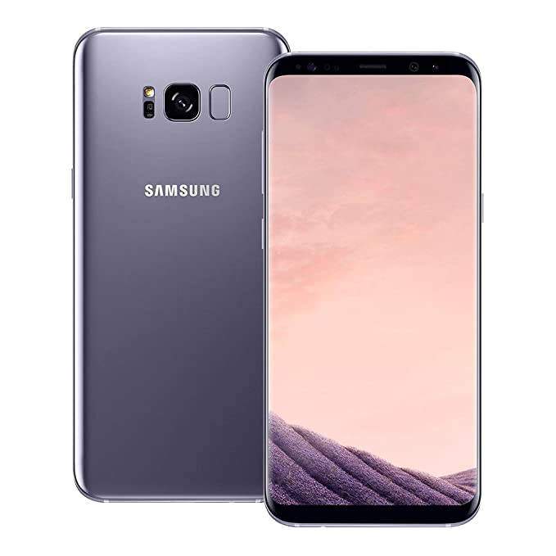
1. You will need new hardware

Slide 9
1. You will need new hardware 2. But it’s backward compatible

Slide 10
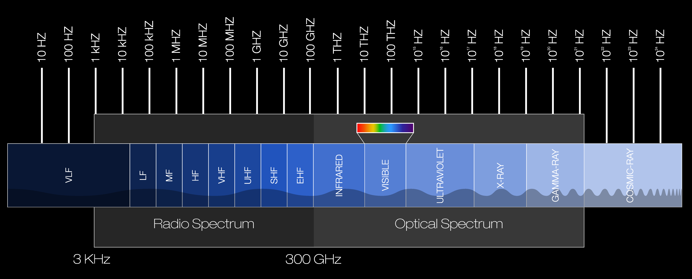
3. You can achieve high speed OR long range

Slide 11
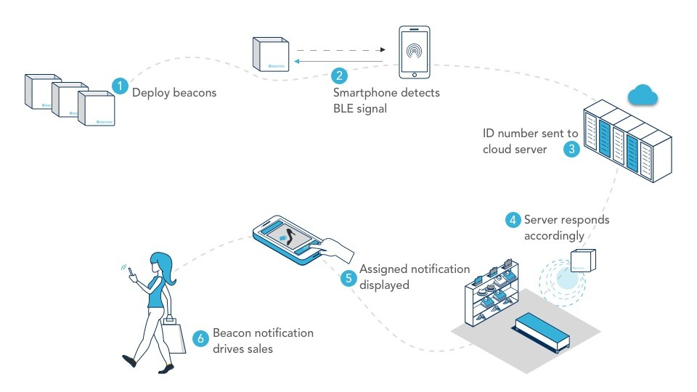
4. Bluetooth 5 and IoT

Slide 12
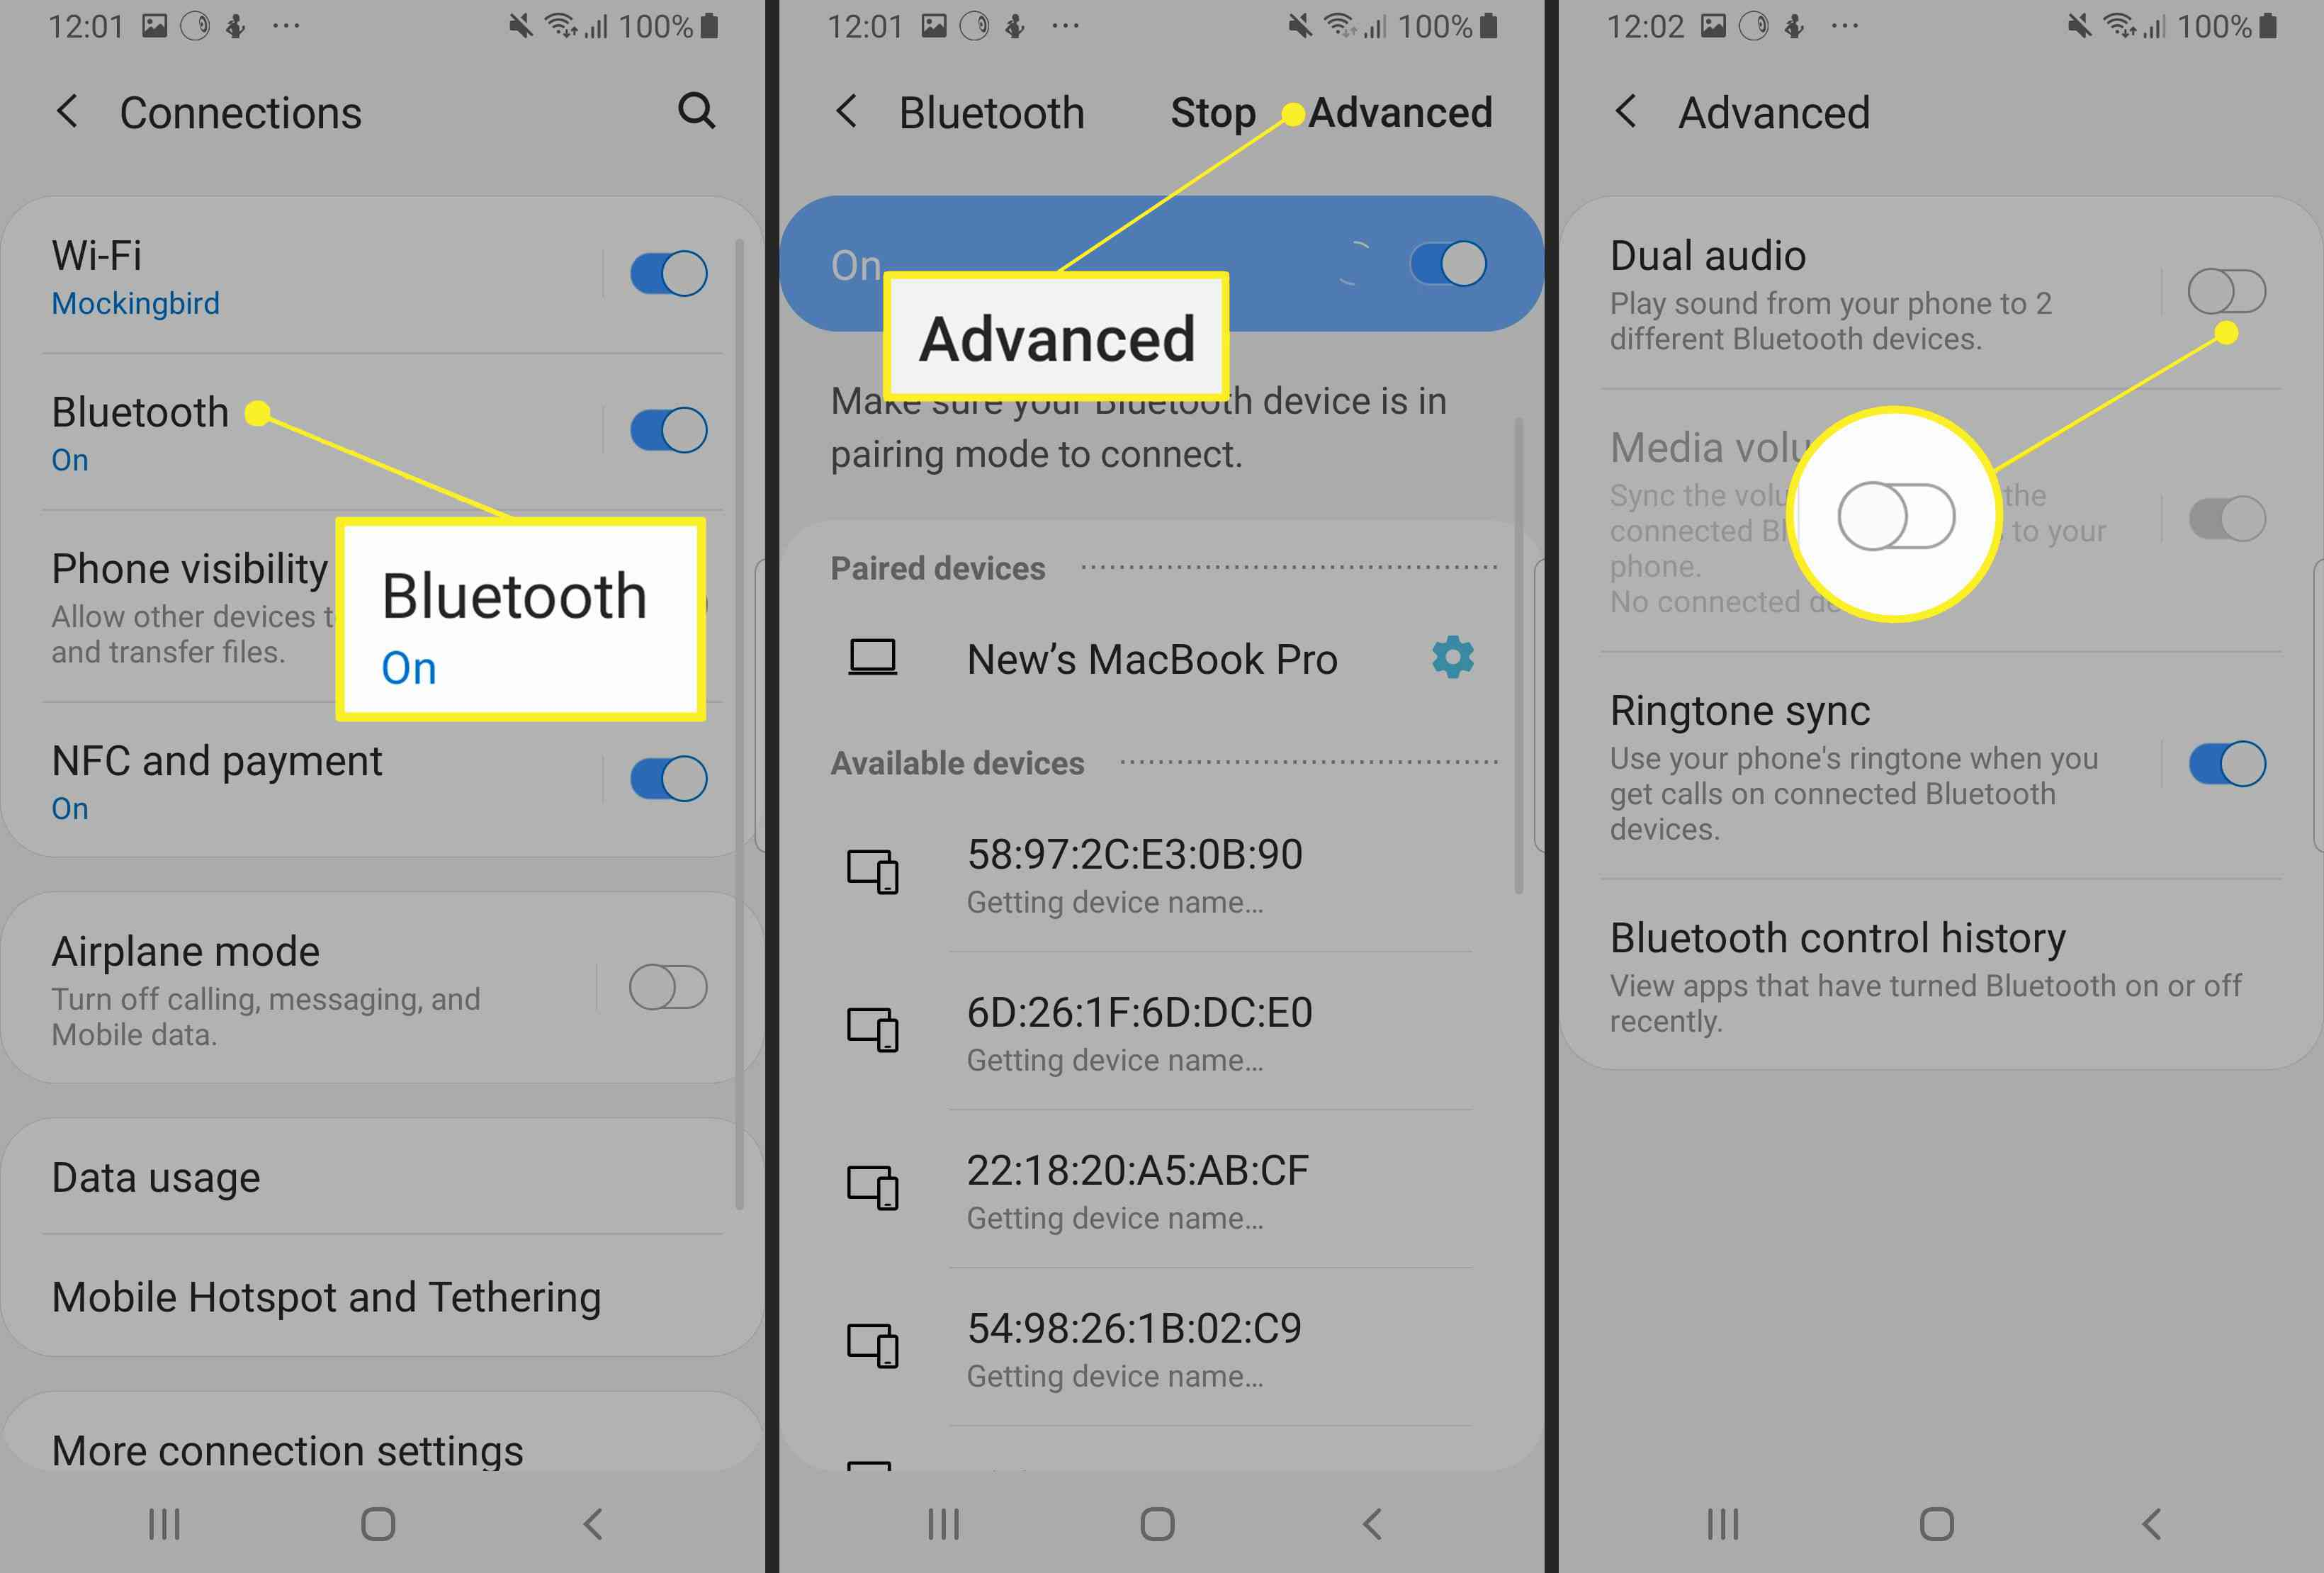
5. Dual audio feature

Slide 13
Security Concerns for Bluetooth 5 technology
Bluetooth implements authentication, confidentiality and key generation with custom algorithms
based on the SAFER+ block cipher.
Bluetooth key generation is based on a bluetooth pin, which must be entered into both devices.
There is history of security concerns for bluetooth technology which are listed as follows:
Blue bug
- Poor implementations of bluetooth security led to disclosure of personal data. In 2004 the first virus using bluetooth to spread itself among mobile phones appeared on the symbian OS. The virus was first described by kaspersky lab.
Lasco
- A mobile malware targeted mobile phones using symbian OS using bluetooth enabled devices to replicate itself and spread to other devices.
Blue borne
- It allows an attacker to connect to devices or systems without authentication and can give them virtually full control over the device.

Slide 14
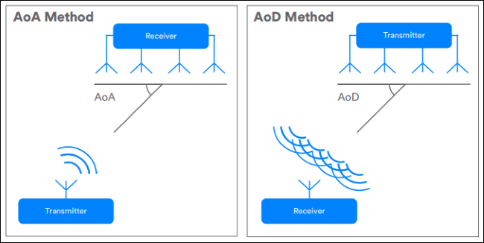
Intro about Bluetooth 5.1:
The main feature that differs Bluetooth 5.1 from other versions of Bluetooth is the direction signal.
features added to Bluetooth 5.1 which are stated below:
1. Direction Finding:
“direction-finding” features that will let Bluetooth devices pinpoint physical location to the centimeter, aiding in indoor positioning.

Slide 15
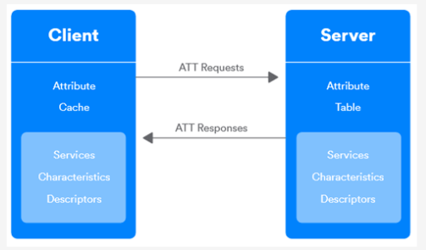
Improve GATT caching:
GATT Caching or Generic Attribute Profile Caching helps in the Bluetooth connection process between two devices.
Typically it starts when the connection process runs & it checks what the receiver device can support, the GATT service of that device, the characteristics & various structural values & details.

Slide 16
Enhance Bluetooth Advertising:
Bluetooth advertising refers to the way by which various Bluetooth devices let know that they are available to be connected.
the most annoying thing is, trying to connect to a device several times but failing.
Bluetooth 5.1 enhanced advertising features that avoid these types of problems by announcing that they are available for the nearest Bluetooth devices.
Faster connection & less Power Consumption:
The enhanced Bluetooth advertising allows your device to connect fast, transfer data fast & use less power.
There is also a new sleep clock accuracy update when you will move to Bluetooth 5.1. This added feature will use minimum power overnight.

Slide 17
APPLICATIONS
Smart Home Automation
In the field of smart homes, there is a constant increase in number of applications. More and more manufacturers are focussing on refits in building technology.
Previously, the relatively short range of Bluetooth applications was the reason for its limited use in smart home sector.
The individual applications can be controlled quickly and easily via a smartphone or tablet.
The Special Interest Group(SIG) estimates by 2020 there will be over 48 billion internet-compatible devices worldwide, most of which will be filled with Bluetooth.
Bluetooth 5 will provide or is providing greater flexibility.
In addition, to transmission requirements, the topology, the structure of network is also important .

Slide 18
In 2017, mesh topology was introduced by SIG with which it is now possible to set up Bluetooth automation network with up to 32000 nodes communicating with each other.
Ideally, the devices speak to each other directly and there is no need for central distribution station. This we call a fully meshed network.
Bluetooth uses an Authenticated Encryption procedure with 128-bit AES encryption which ensures both confidentiality and integrity of data transmitted.
Hence, Bluetooth is also able to fulfil security requirements since in a meshed network all communication is encrypted.
Extending broadcast channels means that there is a definite increase in application cases for one-to-many communication. So-called beacons, small Bluetooth transmitters, play an ever increasing role.

Slide 19
CONCLUSION
Bluetooth wireless technology – The technology that propels us into a new dimension in wireless connectivity. With rapid growth in technology, the features of Bluetooth are also getting updated to meet up with the requirements of new innovative technologies.

Slide 20
Thank you
Any questions?

